Slide 1
Technology overview

Slide 2
Abstract and learning objectives
Abstract and learning objectives
Brief review of technologies and concepts featured in design challenge.

Slide 3
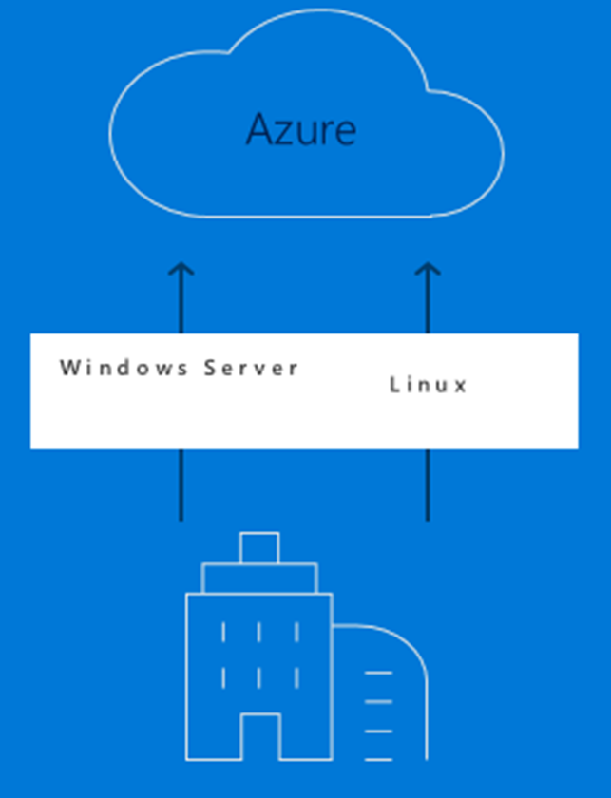
Common scenarios – Azure Migrate
Easily discover VMWare VMs and applications including service dependencies
Workload assessments
Right-size Azure resources based on utilization history
Estimate monthly costs in Azure
Migration risks and recommended tools
Hyper-V support coming soon
Leverage Azure Site Recovery Deployment Planner or partner tools for these workloads
Notes:
https://docs.microsoft.com/en-us/azure/migrate/migrate-overview#current-limitations
Note that support for Hyper-V is on the roadmap.
Hyper-V
Partner tools

Slide 4

Common scenarios – Database Migration Service
Migrate from multiple database sources to Azure Data platforms with minimal downtime
Generate assessments of all recommended changes
Perform associated migration steps
Notes:
DMA & DEA (A & B testing)

Slide 5
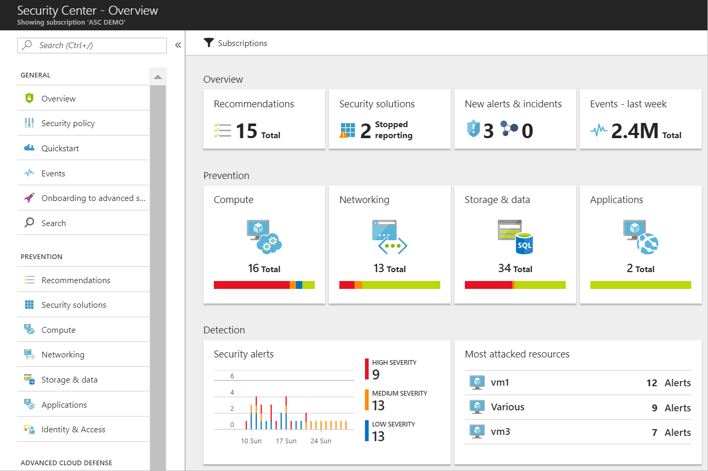
Common scenarios – Azure Security Center
Unified view of security across on-premises and cloud workloads.
Identify and remediate vulnerabilities
Advanced threat protection
Centralized security policies

Slide 6
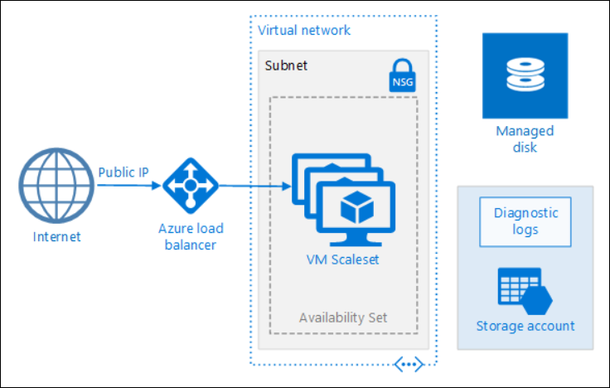
Common scenarios
Azure Virtual Machine Scale Sets)

Slide 7
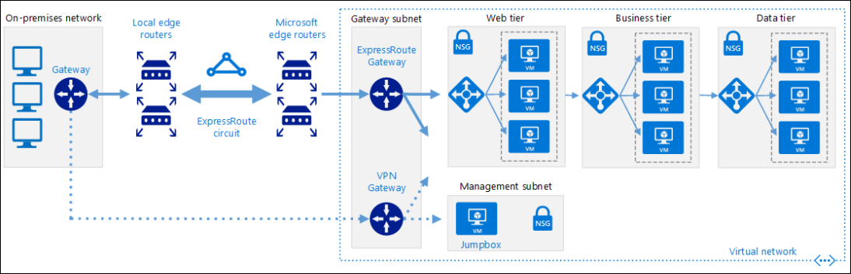
Common scenarios
ExpressRoute with VPN failover

Slide 8
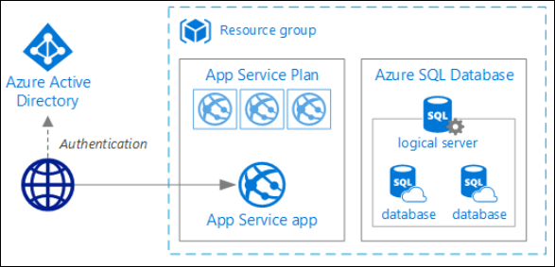
Common scenarios
Azure App Service

Slide 9

Common scenarios
Azure Database for MySQL

Slide 10
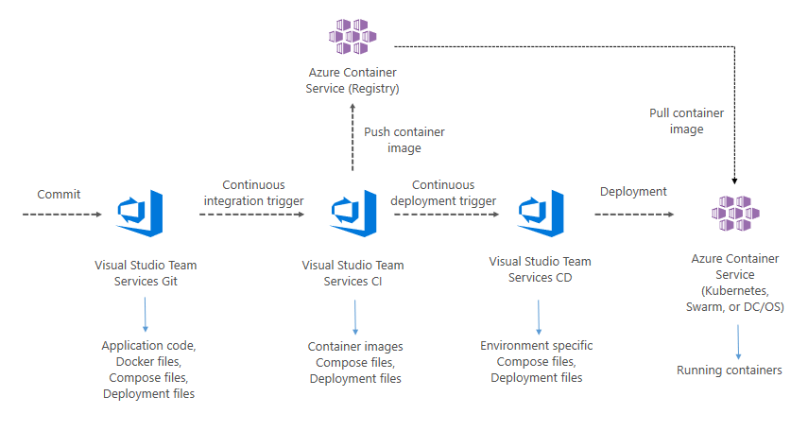
Common scenarios
VSTS for CICD to Azure Kubernetes Service (AKS)

Slide 11
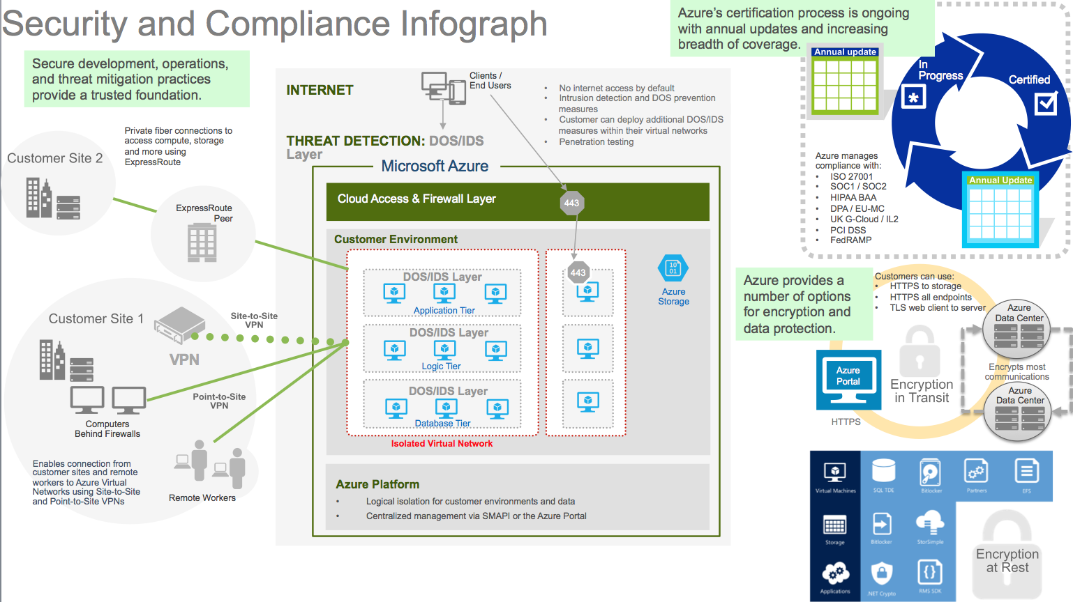
Common scenarios

Slide 12
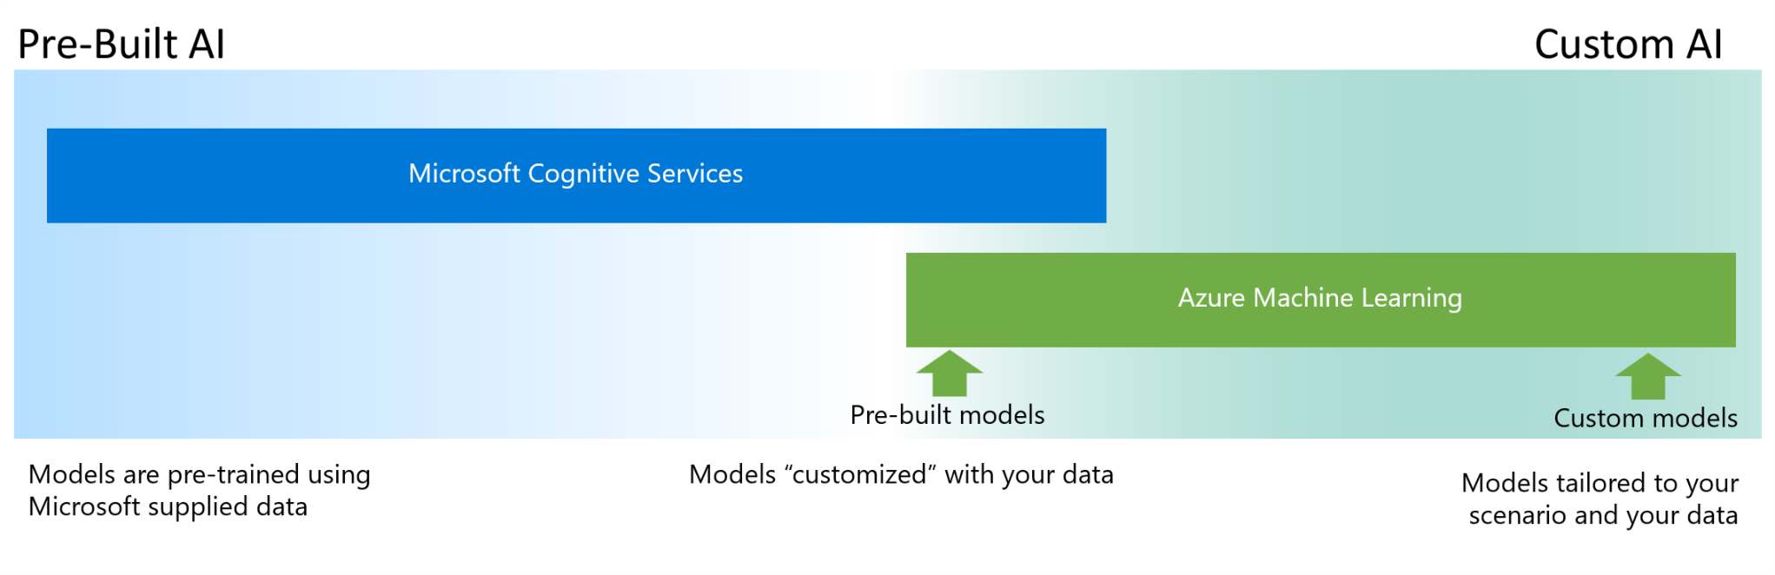
Common scenarios – AI Spectrum

Slide 13

On to the design challenge!

